Slide 1
Stakeholder Management
PMI Knowledge Areas

Slide 2
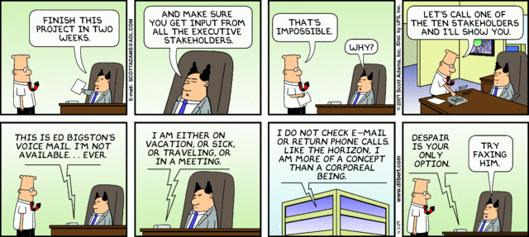
Importance of Project Stakeholder Management
Identify all people or organizations affected by a project, to analyze stakeholder expectations, and to effectively engage stakeholders

Slide 3
Change and Organizational Impact
Projects often cause changes in organizations, and some people may lose their jobs when a project is completed.
Project managers must learn to identify, understand, and work with a variety of stakeholders
Examples of Stakeholder Impacts from cases

Slide 4
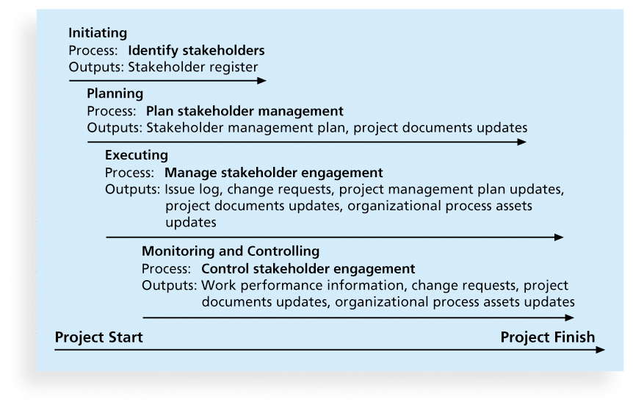
Project Stakeholder Management Processes
Identifying stakeholders
Planning stakeholder management
Managing stakeholder engagement
Controlling stakeholder engagement

Slide 5
Identifying Stakeholders
Internal project stakeholders
External project stakeholders
Additional Stakeholders:
Program Director
Labor Unions
Potential Customers

Slide 6
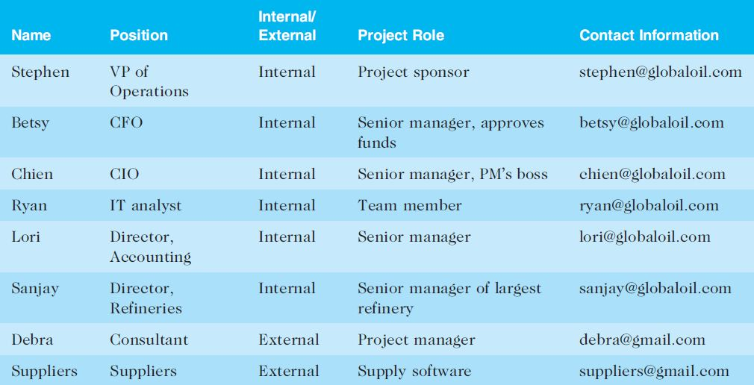
Stakeholder Register
A stakeholder register includes basic information on stakeholders

Slide 7
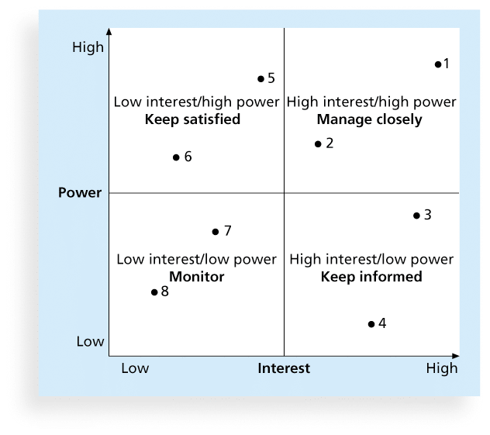
Classifying Stakeholders
A power/interest grid can be used to group stakeholders based on their level of authority (power) and their level of concern (interest) for project outcomes
Engagement Levels:
Unaware
Resistant
Neutral
Supportive
Leading

Slide 8
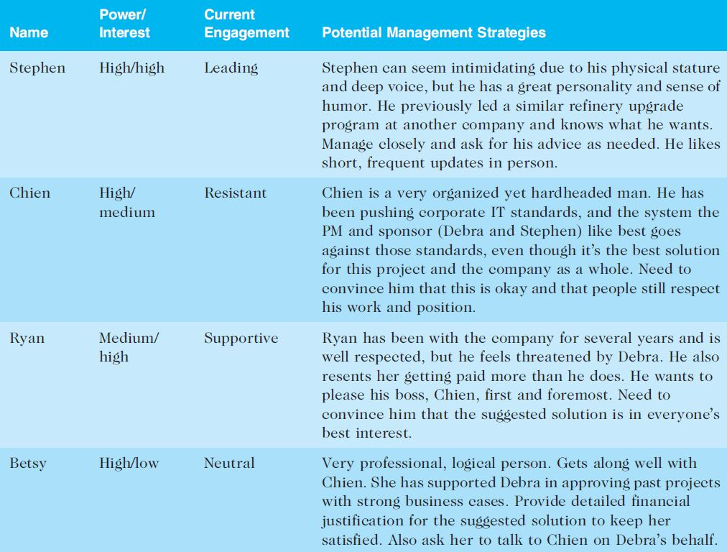
Sample Stakeholder Analysis

Slide 9
Planning Stakeholder Management
After identifying and analyzing stakeholders, project teams should develop a plan for management them
Limit Availability
Restrict who prepares it
Don’t write everything down

Slide 10
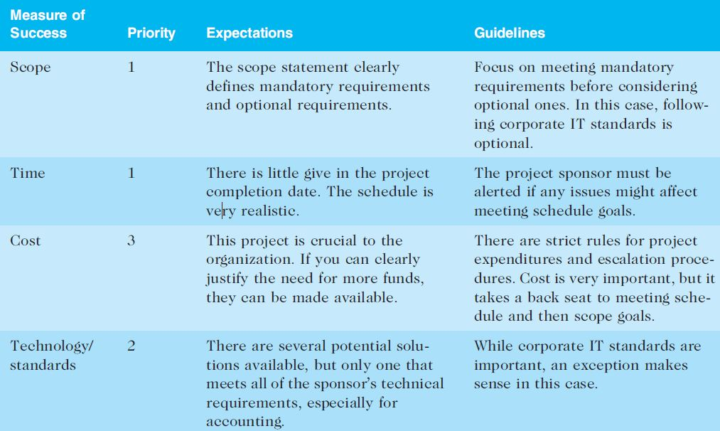
Managing Stakeholder Engagement
Project success is often measured in terms of customer/sponsor satisfaction
Expectations Management Matrix

Slide 11
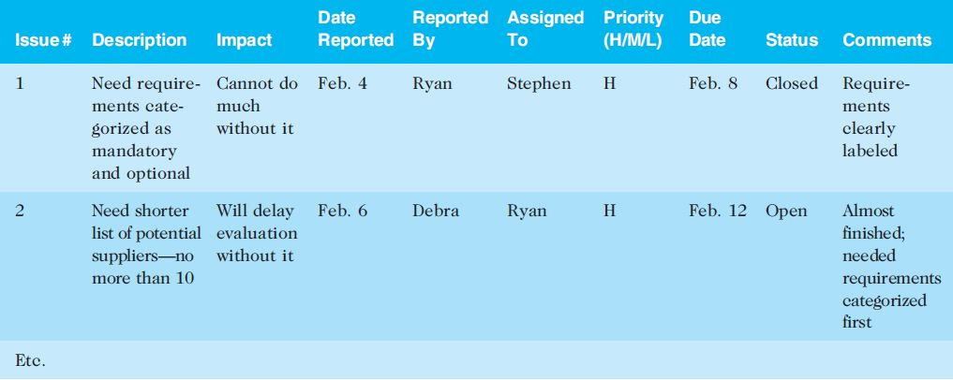
Issue Logs
Understanding the stakeholders’ expectations can help in managing issues
Issues should be documented in an issue log, a tool used to document, monitor, and track issues that need resolution

Slide 12
Best Practice
Project managers are often faced with challenges, especially in managing stakeholders
Suggestions for handling these situations include the following:
Be clear from the start
Explain the consequences
Have a contingency plan
Avoid surprises
Take a stand

Slide 13
Controlling Stakeholder Engagement
Can you control stakeholders?

Slide 14
Ways to Control Engagement
Participation in kick-off meetings
Meet before hand with key stakeholders
Engagement activities and deliverables throughout the project
Stakeholders As Key Project Team Members
On some IT projects, important stakeholders are invited to be members of the project teams (Example: Northwest Airlines and ResNet)

Slide 15
Social Media for Project Managers
Elizabeth Harrin, author of Social Media for Project Managers, describes the pros and cons of several social media tools, including blogs, collaboration tools, instant messaging, microblogs like Twitter and Facebook, podcasts, RSS, social networks, vodcasts (video podcasts), webinars, and wikis
Harrin provides advice for when to use social media and when not to use it

Slide 16
Chapter Summary
Managing stakeholders is now the tenth knowledge area in the PMBOK® Guide.
Processes include:
Identify stakeholders
Plan stakeholder management
Manage stakeholder engagement
Control stakeholder engagement

